Slide 1
Effective, Cost Efficient, and Highly Targeted Advertising
Helping Businesses Reach Local Consumers Since 1951

Slide 2
2,600+ Active Business
Clients
A+ BBB
Rating
60+ Years of
Building
Brands
3,000+ Stores
Across
The US

Slide 3
Unmatched Exposure
The average consumer spends over 40 minutes per shopping visit. Compare that with the expensive TV and radio spots, or billboards.
Your message is seen by the customer week after week as they visit their local grocery store
The average household visits their local grocery store 9 times per month.
01
Focused Promotion
With AdCart, BiLo and Ingles you reach customers when they have shopping on their mind.
02
Highly Targeted Advertising!
Your brand is seen by the person in charge of purchasing for the household.
03

Slide 4
Adjacent to isle directory for maximum exposure

Slide 5
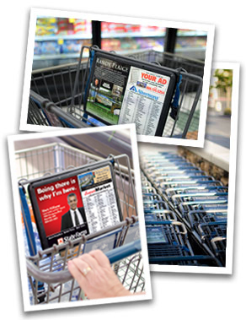
Always in the customer’s sight, always on the customer’s mind!

Slide 6
20%
80% female
80%
Primarily female customer base, which is known for higher volume
Vast majority of shoppers have attended college
Very high proportion of customer base is above 45 years of age
15%
85% have attended college
85%
35%
65% over 45 years
of age
65%

Slide 7
30%
70% female
70%
Primarily female customer base, which is known for higher volume
Above average proportion of customers with 65k+ HHI
95% have attended college
More than half of the customer base is above 55 years of age
10%
90% with 65k+ HHI
90%
55% above 55 years of age
45%
55%

Slide 8
8
Message Frequency
Per 10 Stores = 150,000 Weekly Visits
150,000 x 3 impressions per Visit = 450,000 Impressions per week
Brand Saturation
Per 10 Stores= 150,000
Weekly Visits 150,000 x 40 min = 100,000 Hours of Exposure per Week
High Level Of Exposure = Strong Brand
Recognition

Slide 9
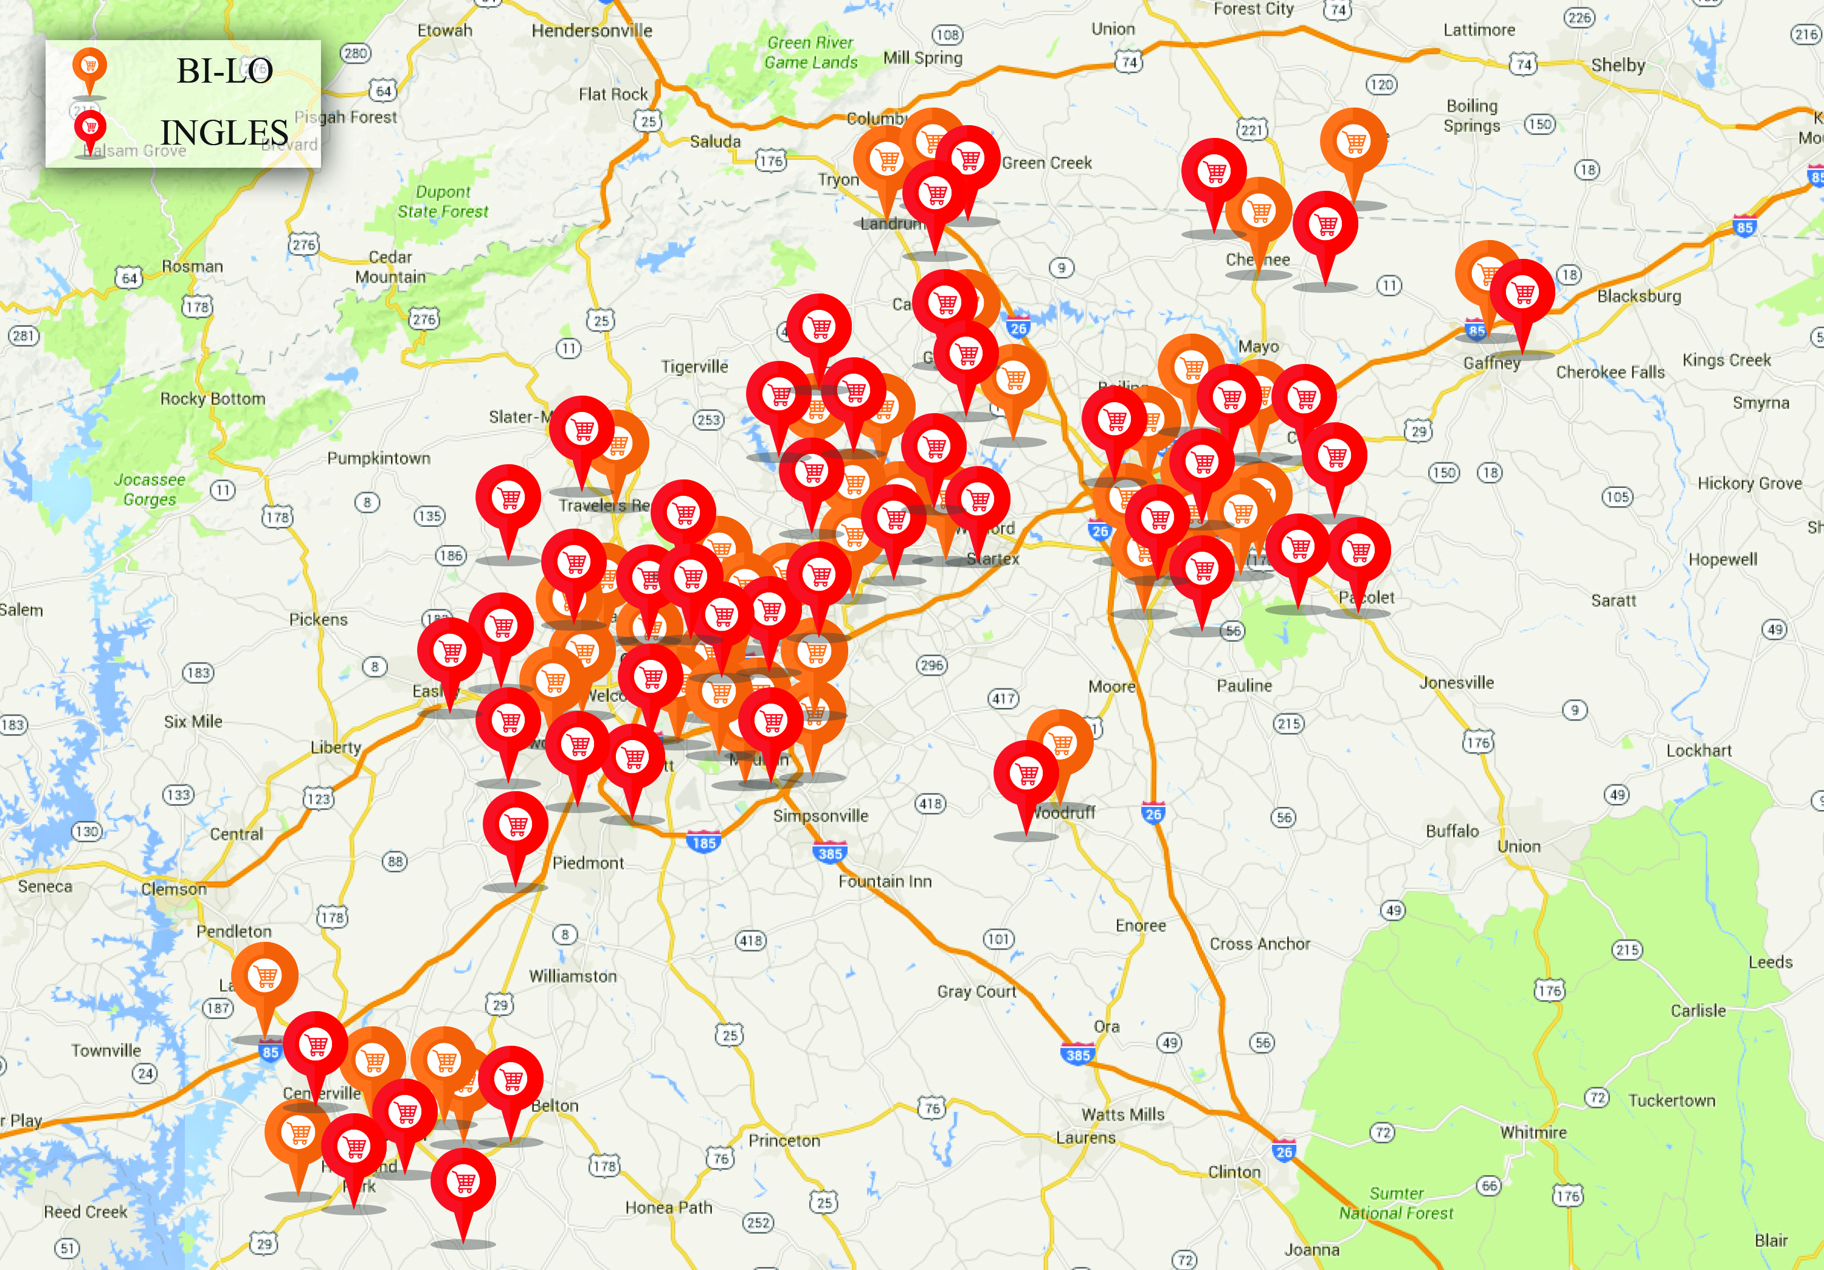
464,600 Upstate Area Weekly Shopping Visits

